Slide 1

Riyadh’s metro station prediction
By: Hazim Bukhari

Slide 2
Business Problem.
A new metro is being built in Riyadh.
What if we can predict the crowded stations and plan?

Slide 3
How to solve it?
Use
MTA data set.
Extract
Most crowded stations.
Find
Land use near these stations.
Map
Findings to Riyadh’s metro stations.

Slide 4
Why MTA?
Top 10 subway systems worldwide.
Easily accessible data.

Slide 5
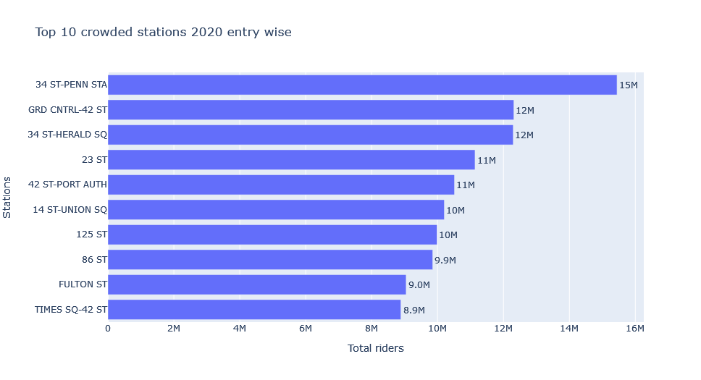
Findings

Slide 6
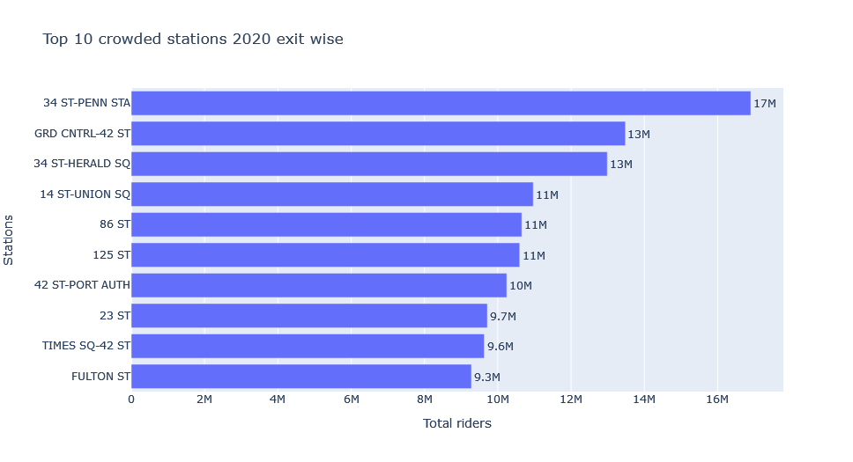
Findings Cont.

Slide 7
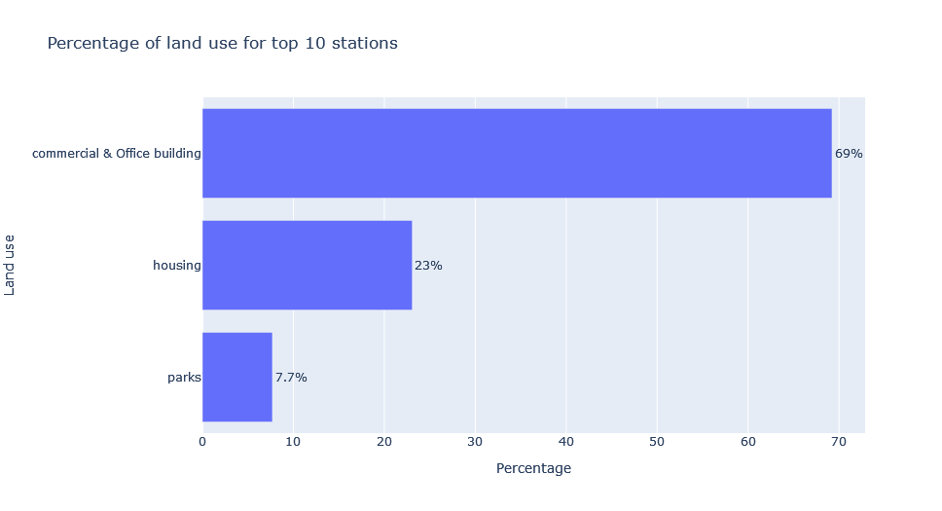
Findings Cont.

Slide 8
Mapping to Riyadh’s metro.
Below are the Riyadh’s stations based on our analysis:
King Abdullah Financial Center Station.
King Abdulaziz City for Science and Technology.

Slide 9
Final Thoughts
More stations could be identified.
Universities are a grey area.

Slide 10

Thank you

